Slide 1
Mapping with iD Editor

Slide 2
Understand importance of knowledge of iD for validation
Learning objectives
Use advanced iD features
Spot common iD errors / bugs

Slide 3
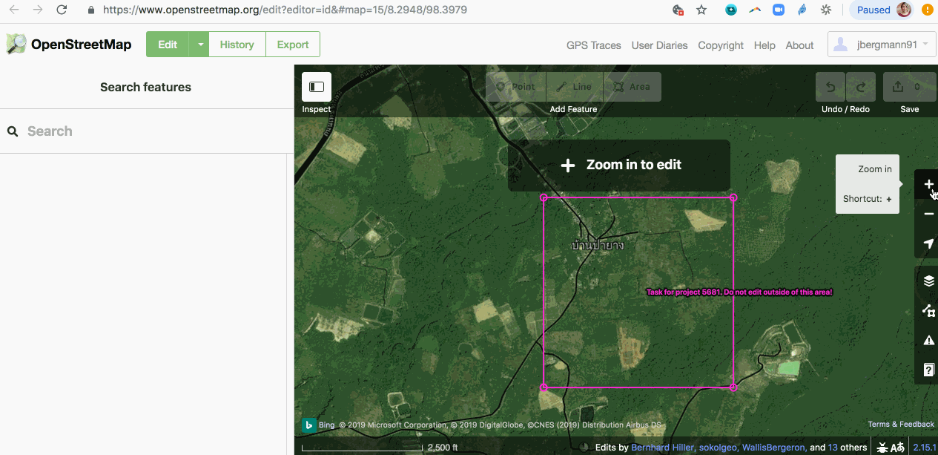
Intro to iD Editor
The iD editor is a user-friendly tool that allows you to directly make changes in OpenStreetMap from an internet browser
iD is a good option for making simple edits when consistent internet access is available. It does not require any software to be installed or downloaded
Notes:
Almost all new mappers use iD because it does not require any setup

Slide 4
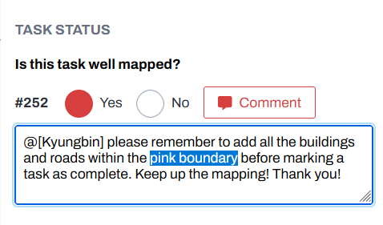
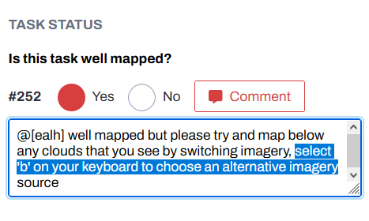
But iD is for beginners!
As validators, to give constructive feedback to new mappers it is essential to know about the tools that beginners are using
By being aware of the strengths and weaknesses of the iD editor you can better anticipate errors and issues you’re likely to come across as a validator

Slide 5
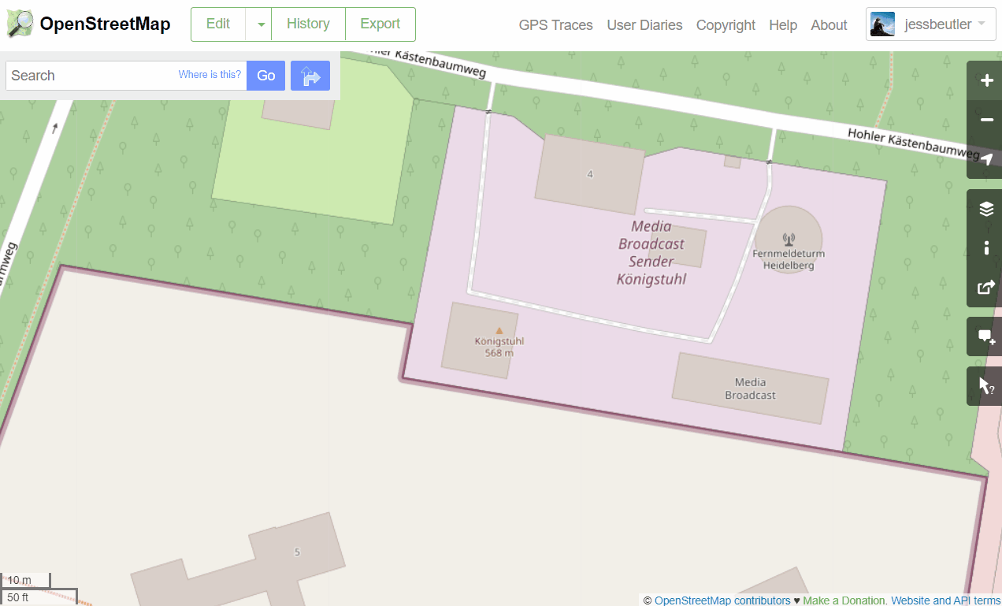
Starting from OSM.org
If starting from the OSM website:
Click the down arrow next to the ‘Edit’ buttom.
Press ‘Edit with iD’ to open the iD Editor in your browser.

Slide 6
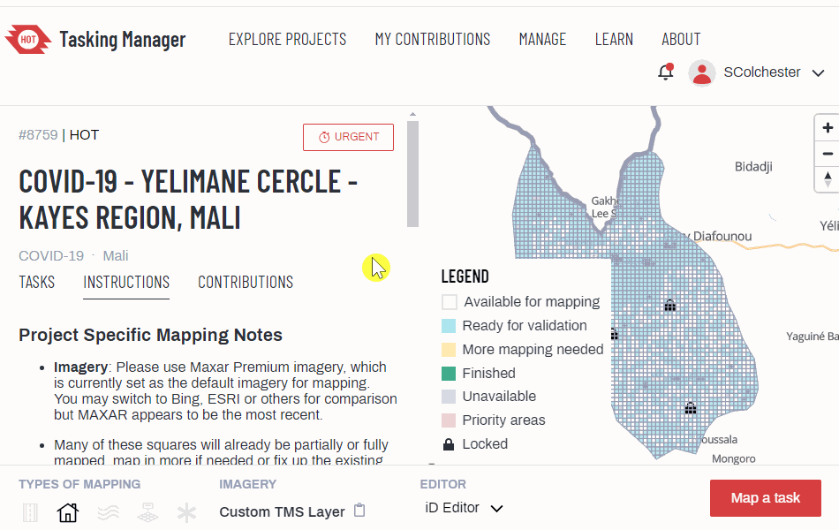
Starting from Tasking Manager
If starting from the HOT Tasking Manager:
Leave ‘iD Editor’ as your choice editor.
Press ‘Map a task’ to zoom into a task and open the editor
Map within the boundaries of the pink square!

Slide 7
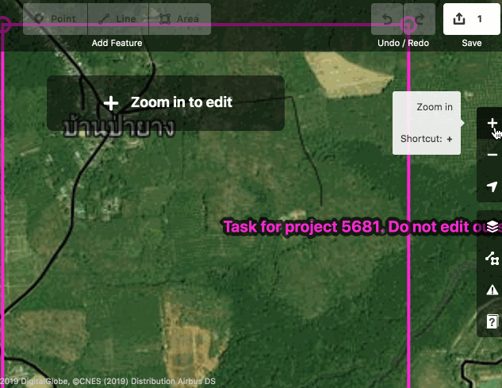
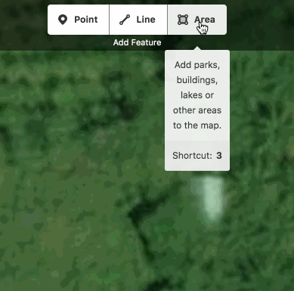
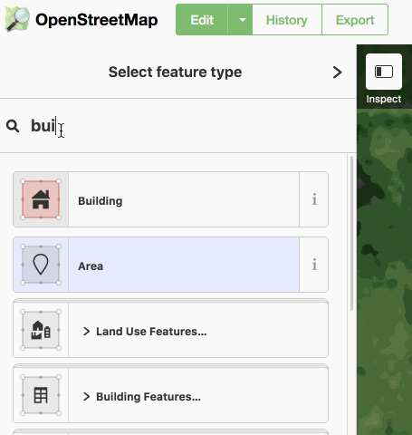
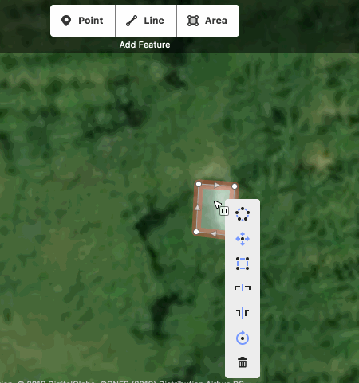
Mapping Square Buildings
FIND
TRACE
TAG
1
2
4
3
SQUARE
Select the ‘Area’ tool, and trace over the shape of the building, clicking in each corner. Double click on the last point to finish.The shape will flash red.
Tag the building using the left hand menu. Enter ‘Building’ in the search panel and select - the building will turn red.
Now, make your building a perfect square. Click the centre of the building and hit ‘Q’ on your keyboard to make the corners of the building 90 degrees.
Zoom in close to the top left of your square. Start moving through the square using your mouse or left/right arrows until you find a square building.

Slide 8
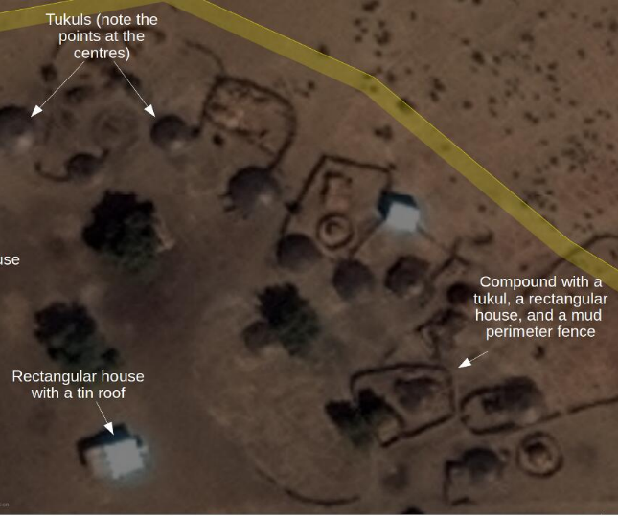
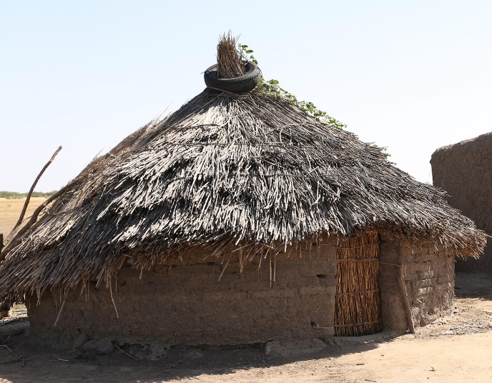
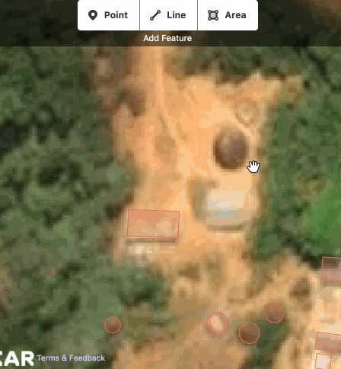
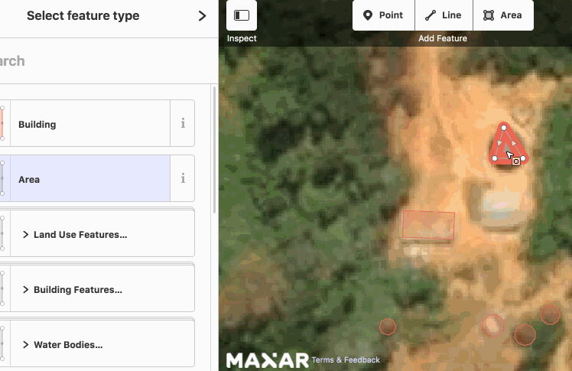
Mapping Round Buildings
1
2
Circular buildings are harder to spot as it’s easy to confuse them with trees. Look out for defined half moon shadows, raised points in the centre, and surrounding paths and fencing.
What the hut will look like on the ground.
Map circular buildings the same way you map square buildings. Select Area, then click three points in the shape of a triangle over the building.
Double click on the last point to finish the building. Click the centre of the building, then hit the ‘O’ key on your keyboard. Remember to tag it as a building.

Slide 9
Mapping Buildings Recap
1
FIND
2
TRACE
3
TAG
SQUARE/CIRCLE
4

Slide 10

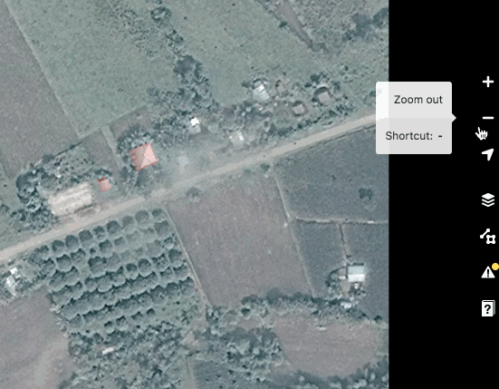
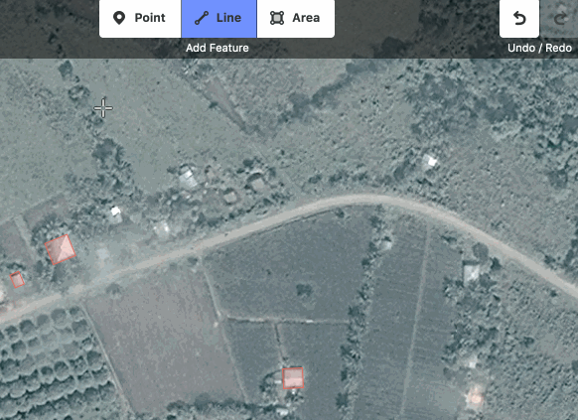
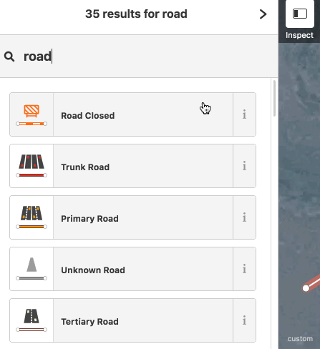
Mapping Roads
1
FIND
2
TRACE
3
TAG
Tag the road. There are a number of options, but the most common are:
Unclassified: if your road connects separate building clusters in rural areas
Residential: if your road is lined with buildings and is within a settlement
Zoom out of your square to look for roads and find where they connect villages/cities.
Select the Line tool. Click where the road starts and continue clicking each time the road changes direction. Double click on the last point to end the line.
Notes:
e.g. https://tasks.hotosm.org/projects/9068
Ensure Nigerian Government and NGOs can use road data for contact tracing through their ambulance drivers as well quick and safe referrals for the people.
Road mapping is a little harder than building mapping. There are lots of small paths which lead to fields, which are not important to map. We need to know navigation + connectivity, so map roads that are connecting places e.g. villages and cities.
Most of the roads are unpaved. This does not mean that we will map all roads as track. Our road typology is rather based on the road importance and not on the surface or visual appearance.
It is easier to see connectivity when you zoom out on your square. If a road crosses the edge of your square, just map it up until you meet the pink link of your square.
Use the cursor to mark out the road - click your mouse at any point there is a bend in the road so that your drawing follows the road as accurately as possible, but with the fewest number of points/clicks needed.
In most of the cases you will start mapping new roads starting from already existing ones. Make sure that the first point of your line starts on the other road. Don’t leave a gap between the two roads. Also if two roads are intersecting, make sure they are connected.
If your road is longer than your ‘pink square’, draw the road as good as you can and ‘hand it over’ by placing the last point of the road just outside your square so the next mapper can take it on from there.
Don’t confuse roads with dry rivers and streams!
To label, double click or ctrl-click on the road (not a node) and from left hand panel select road feature and then type of road. You will mostly need to tag Residential Roads or ‘Unknown’ roads.
Find additional descriptions of road tags on https://wiki.openstreetmap.org/wiki/Highway_Tag_Africa

Slide 11

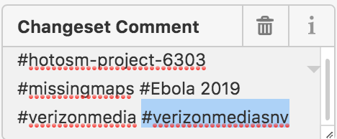
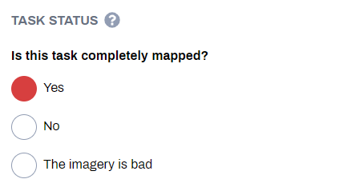
Saving in iD
1
2
3
Save your work every 10 or so edits by clicking the ‘Save’ button. The number next to this button is how many edits you’ve made since your last save.
When you save your work, add any necessary or additional hashtags to the Changeset Comment. After the tags try to add any details about the edits that you made.
When you’ve finished mapping everything in your square select ‘Yes’ to answer ‘Is this task completely mapped?’
If the square is not complete just choose ‘No’ and for both options select ‘Submit task’

Slide 12
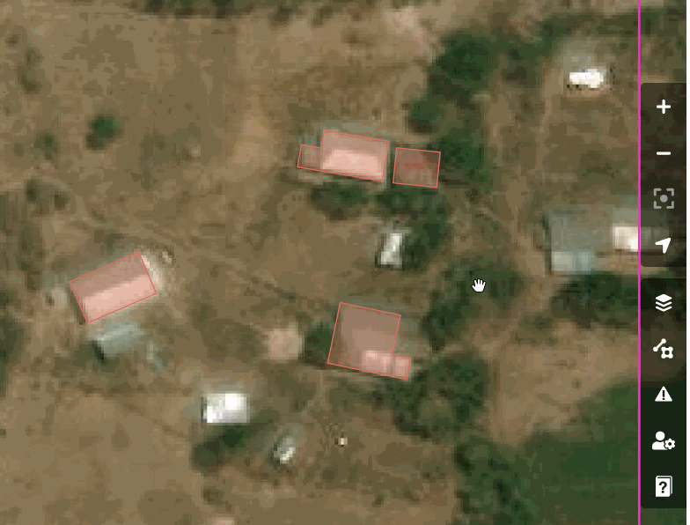
Key iD Features: Imagery
If a project is set up correctly the imagery which mappers are told to use in the instructions will load automatically
Nonetheless, imagery adjustments can be made, including offsets, display options and alternate sources can be loaded for comparison

Slide 13
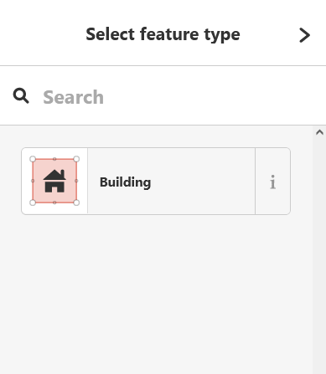
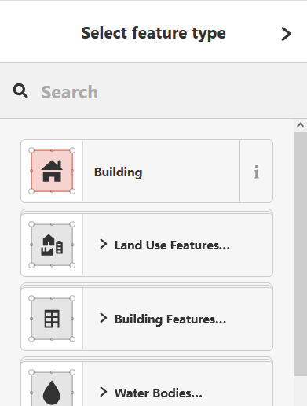
Key iD Features: Presets
PRESETS
NO PRESETS
Projects that are designed for beginners will often have the tags restricted (preset), most often this is used for buildings-only projects
This limits the amount of damage that new mappers can do - it only allows them to add the feature(s) they are asked to map

Slide 14
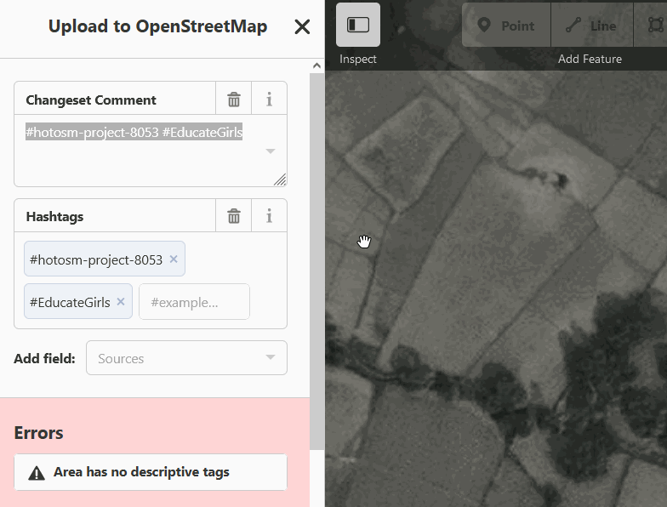
Key iD Features: Errors
The iD editor blocks the upload process if it detects an error. Mappers have to resolve all errors in their mapping before proceeding
Most commonly this is seen when mappers fail to tag an object, this is fixed by clicking on the error and adding the correct tag
Notes:
Unfortunately it does not detect un-squared buildings / overlapping buildings / buildings drawn with the line tool

Slide 15
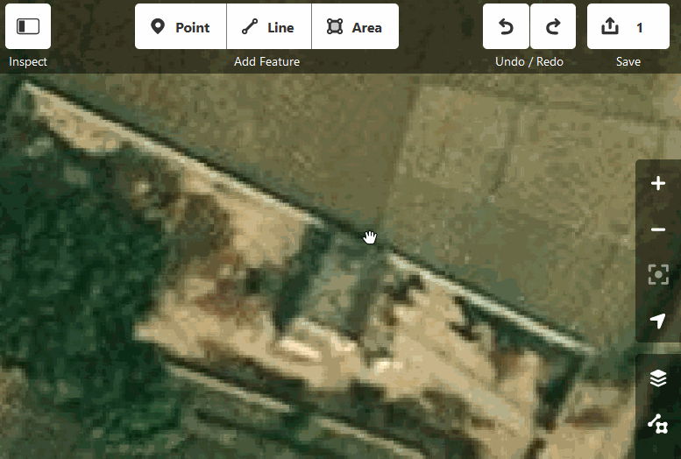
iD Pitfalls: Unsquared Buildings
JOSM users love the buildings plugin, there is no equivalent for iD - buildings mapped in iD by beginners therefore often have unsquared corners
A ‘bug’ in iD also means that any buildings with extreme angles will not be squared properly

Slide 16
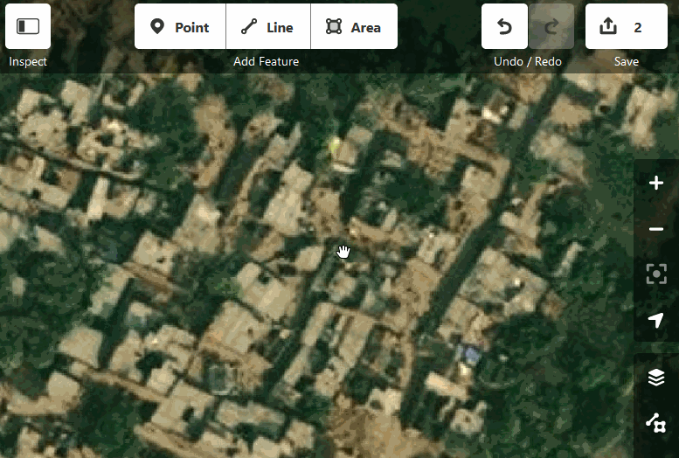
iD Pitfalls: Duplicated Buildings
In order to save processing power the iD editor often does not load mapped objects unless the user zooms right in
This can often cause mappers to map over the top of existing mapped features, creating duplicates

Slide 17
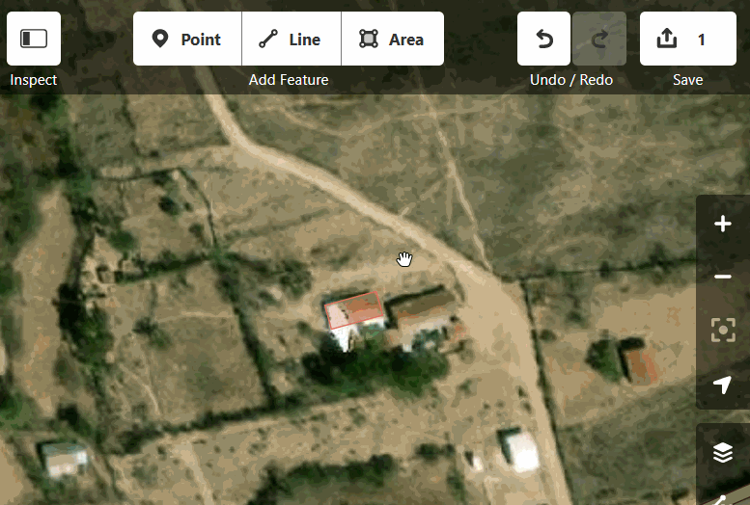
iD Pitfalls: Connected Nodes
The iD editor has a frustrating tendency to snap to existing mapped objects
When iD mappers map buildings close to each other this often causes connected nodes
This can also cause buildings to connect to roads or landuse

Slide 18
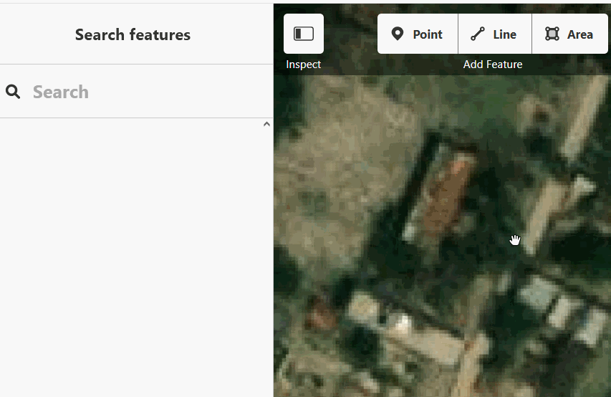
iD Pitfalls: Tagged Corners
In iD it is quite easy to mistakenly select just one corner of a shape while tracing it
When searching for tags the building tag will not show up - mappers often then mark the corner of a building with an incorrect point tag

Slide 19
Workplan
Between now and the introduction to JOSM session (Wednesday) please familiarize yourself with iD by spending ~8 hours mapping a variety of different projects using iD
Please select from any of these projects and try and map several of them so that you map a variety of features (buildings, landuse, highways, waterways):
https://tasks.hotosm.org/projects/8053
https://tasks.hotosm.org/projects/10098
https://tasks.hotosm.org/projects/11210
https://tasks.hotosm.org/projects/11195

Slide 20
Resources
Guides and learning materials:
Advanced iD webinar: https://youtu.be/0tkco5pRyeY

